Slide 1
Classification of Dynamic Contrast Enhanced MR Images of Cervical Cancers Using Texture Analysis and Support Vector Machines
Turid Torheim*, Eirik Malinen, Knut Kvaal, Heidi Lyng, Ulf G. Indahl, Erlend K. F. Andersen, and Cecilia M. Futsæther
Presenter: Dan Zhou

Slide 2
Crux
The aim of the study was to determine whether treatment outcome for 81 patients with locally advanced cervical cancer could be predicted from parameters of the Brix pharmacokinetic model derived from dynamic contrast enhanced magnetic resonance imaging (DCE-MRI).
Features derived from first-order statistics could not discriminate between cured and relapsed patients (specificity 0%–20%, p-values close to unity). However, second-order GLCM features could significantly predict treatment outcome with accuracies (~70%) similar to the clinical factors tumor volume and stage (69%). The results indicate that the spatial relations within the tumor, quantified by texture features, were more suitable for outcome prediction than first-order features.

Slide 3
Literature Review
Previous studies have found correlations between DCE-MRI parameters and treatment outcome for locally advanced cervical cancers, for example in M. A. Zahra et al.
However, these correlations do not necessarily imply that the Brix parameters can be used to predict the treatment outcome for a particular patient.
Thus, the aim of the current study was to examine if the Brix pharmacokinetic classification model were able to predict treatment outcome.

Slide 4
Statistical Features
First-order statistical features of the Brix parameters were used.
texture analysis of Brix parameter maps was done by constructing gray level co-occurrence matrices (GLCM) from the maps.
Clinical factors: tumor volume, FIGO stage

Slide 5
Brix Parameter
A: amplitude
Kep: the transfer rate of contrast agent from the tumor tissue to the blood stream
Kel: the washout rate of contrast agent from the blood plasma.
Notes:
, and were estimated by fitting the
Brix model voxel-by-voxel to the RSI using Levenberg–Marquardt
least squares minimization,

Slide 6
First-Order Statistics
The mean, median, mode, standard deviation, maximum and minimum value, skewness, kurtosis, percentile values, percentile widths of each Brix parameter A, Kep, Kel were calculated for each tumor.

Slide 7
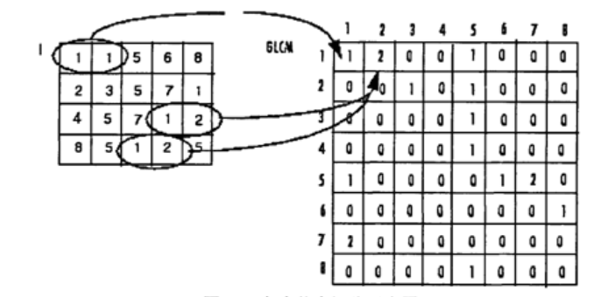
texture analysis of Brix parameter
Method: gray level co-occurrence matrix (GLCM)
The GLCM is calculates how often a pixel with gray-level value i occurs from different direction to adjacent pixels with the value with the value j .
Define distance (step length) and a direction

Slide 8
Second-order statistical texture features
Constant K
Correlation R
Energy E
Homogeneity H
Notes:
can be calculated
from the gray level co-occurrence matrix.

Slide 9
Dataset
The data in this study consisted of dynamic contrast enhanced (DCE) magnetic resonance images of 81 patients with locally advanced cervical cancer.
The median tumor volume was 25 ; 24 for the cured patients and 37 for patients with relapse. 2 tumors had FIGO stage IB, 44 had stage II, 29 had stage III, and six had stage IVA.
$$cm^{3}$$
$$cm^{3}$$
$$cm^{3}$$

Slide 10
Feature Selection
Feature selection was done by sorting the feature variables according to their ability to explain the total variance in the data set as follows.
1) Compute the total variance (T0) of the complete set of available variables, and set the required level (L<100% ) of explained variable variance by the selected subset.
2) Choose among the unselected variables the one with the largest variance.
3) Project the remaining variables onto the orthogonal complement of the subspace spanned by the selected one(s).
4) Compare the total variance (Tr) of the remaining (projected) variables with T0: If 100(1-(Tr/T0))%<L, then return to step 1) for selection of another variable.
5) The final collection of selected variables was used as predictors in the subsequent SVM classification.

Slide 11
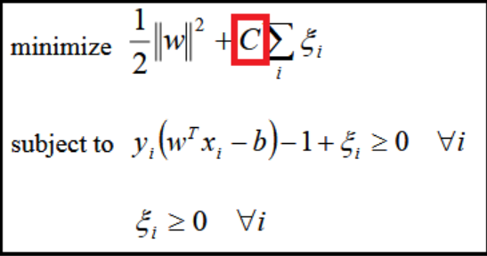
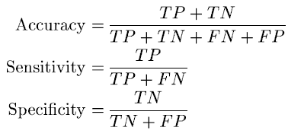
Classification
Support vector machines (SVM): soft margin SVM
classes are not necessarily linearly separable in the original feature space, this paper used the radial basis function(RBF) kernel
Notes:
seeks to find the optimal
separating hyperplane between classes, by choosing the hyperplane
with the maximal margin
where and are object (here patient) and , respectively.
is a shape parameter determining the smoothness of the
boundary between the groups in the original object space

Slide 12
Statistical Analysis and Model Validation
evaluated using ANOVA and post hoc Tukey’s HSD tests with significance level p<0.05
A selection of models were also validated using a leave-one-out cross-model validation

Slide 13
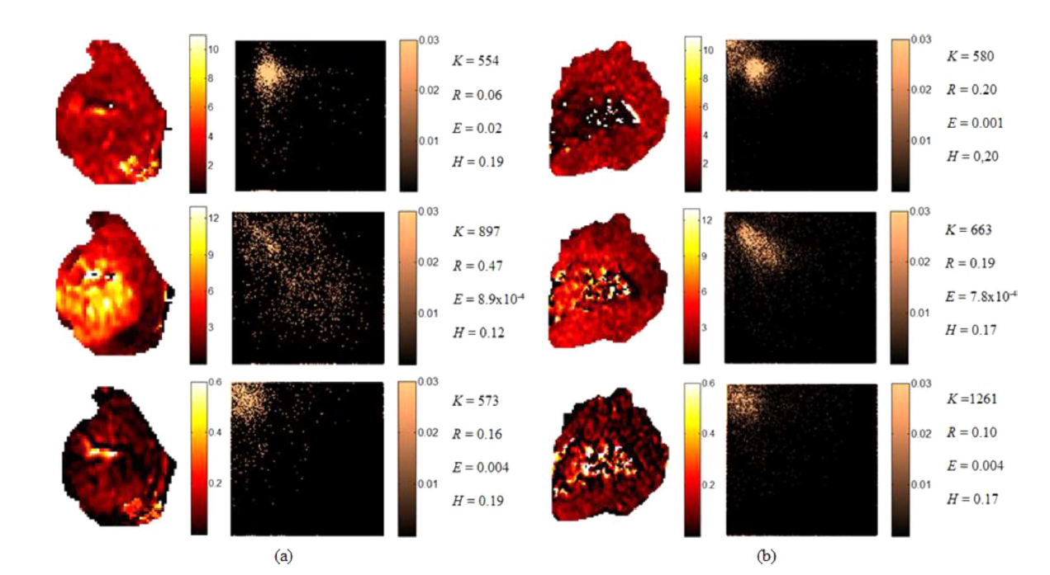
Result
Notes:
Fig. 2. Brix parameter maps (left column) and corresponding GLCMs (middle column) from (a) a relapsed patient with tumor volume 32 cm and FIGO stage II,
and (b) a patient with tumor volume 94 cm and FIGO stage IV that was cured. The 128 128 GLCMs (middle) were constructed from the parameter maps using
diagonal voxel relations and a step length of five voxels. Only voxels from the tumor itself were used to create the GLCMs. The background was not included.
Top row: , the amplitude. Middle row: , the transfer rate of contrast agent from tissue to blood stream. Bottom row: , the washout rate of contrast agent.
For the parameter maps, red indicates low values and white the highest values (see color bar). For the GLCMs, the lightest color shows the highest values (i.e., the
gray level combinations occurring most often), whereas black indicates low values (see color bar). The texture features contrast , correlation , energy and
homogeneity of each parameter map are given in the right column.

Slide 14
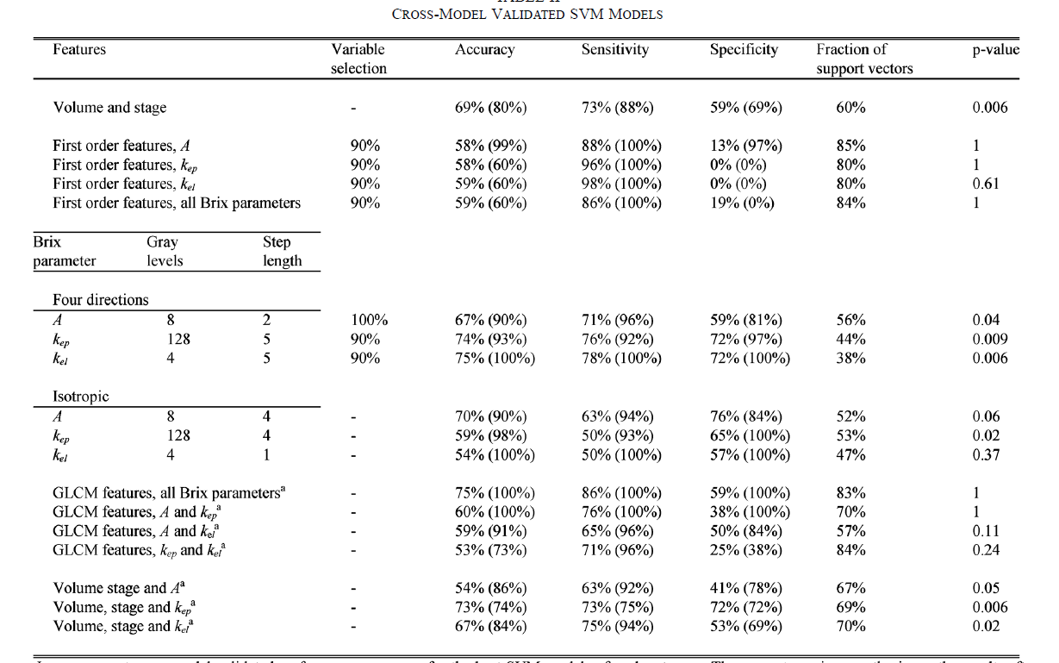

Slide 15
Conclusion
for predicting outcome of chemoradiotherapy for cervical cancer patients, texture features from GLCMs of pharmacokinetic parameter maps derived from DCE-MRI appear to be better predictors than first-order statistical features and can compete with the clinical factors tumor volume and stage.

Slide 16
Thank You!

